Slide 1
ML 24/25-09 Semantic Similarity Analysis of Textual Data
Team: FutureHANds
M A B Siddique Naeem
Md Abdul Ahad
Muhammad Faraz Abbasi
Haimanti Biswas

Slide 2
Table of contents
01
02
03
04
Objectives
Introduction
Methodology
Results & Conclusion

Slide 3

01
Objective

Slide 4
Objective
Key objectives:
Word and phrase similarity analysis
Compare semantic relationships between pair of phrases
Highlight variance in similarity across different domains and contexts
Document-level comparisons
Analyze semantic similarity between documents on the same topic vs. unrelated topics
Provide insights into how contextual alignment impacts semantic similarity
Demonstration and validation
Use well known examples to illustrate findings
Showcase the versatility of semantic similarity metrics across diverse scenarios

Slide 5
02
Introduction

Slide 6
Introduction
What is semantic similarity?
Why OpenAI Embeddings?
Semantic similarity measures how closely related two pieces of text are in meaning.
Applications: Search engines, chatbots, recommendation system etc.
OpenAI’s embedding models (e.g. text-embedding-ada-002, text-embedding-3-small, text-embedding-3-large) provide state-of-art text represantations.

Slide 7

Project Scope:
Analyze semantic similarity at word/phrase and document levels.
Use cosine similarity to compare embeddings generated by OpenAI models.

Slide 8
03
Methodology

Slide 9
System Architecture
The system consists of the following key components:
User Input Handling: Accepts textual data from users via direct input or document upload.
Text Preprocessing: Extracts and cleans text for analysis.
Embedding Generation: Uses OpenAI’s API to generate vector representations of text.
Similarity Computation: Applies cosine similarity to calculate similarity scores.
Result Storage and Output: Saves similarity scores in a CSV file for further analysis.
Visualization: Uses Python for graphical representation of results.

Slide 10
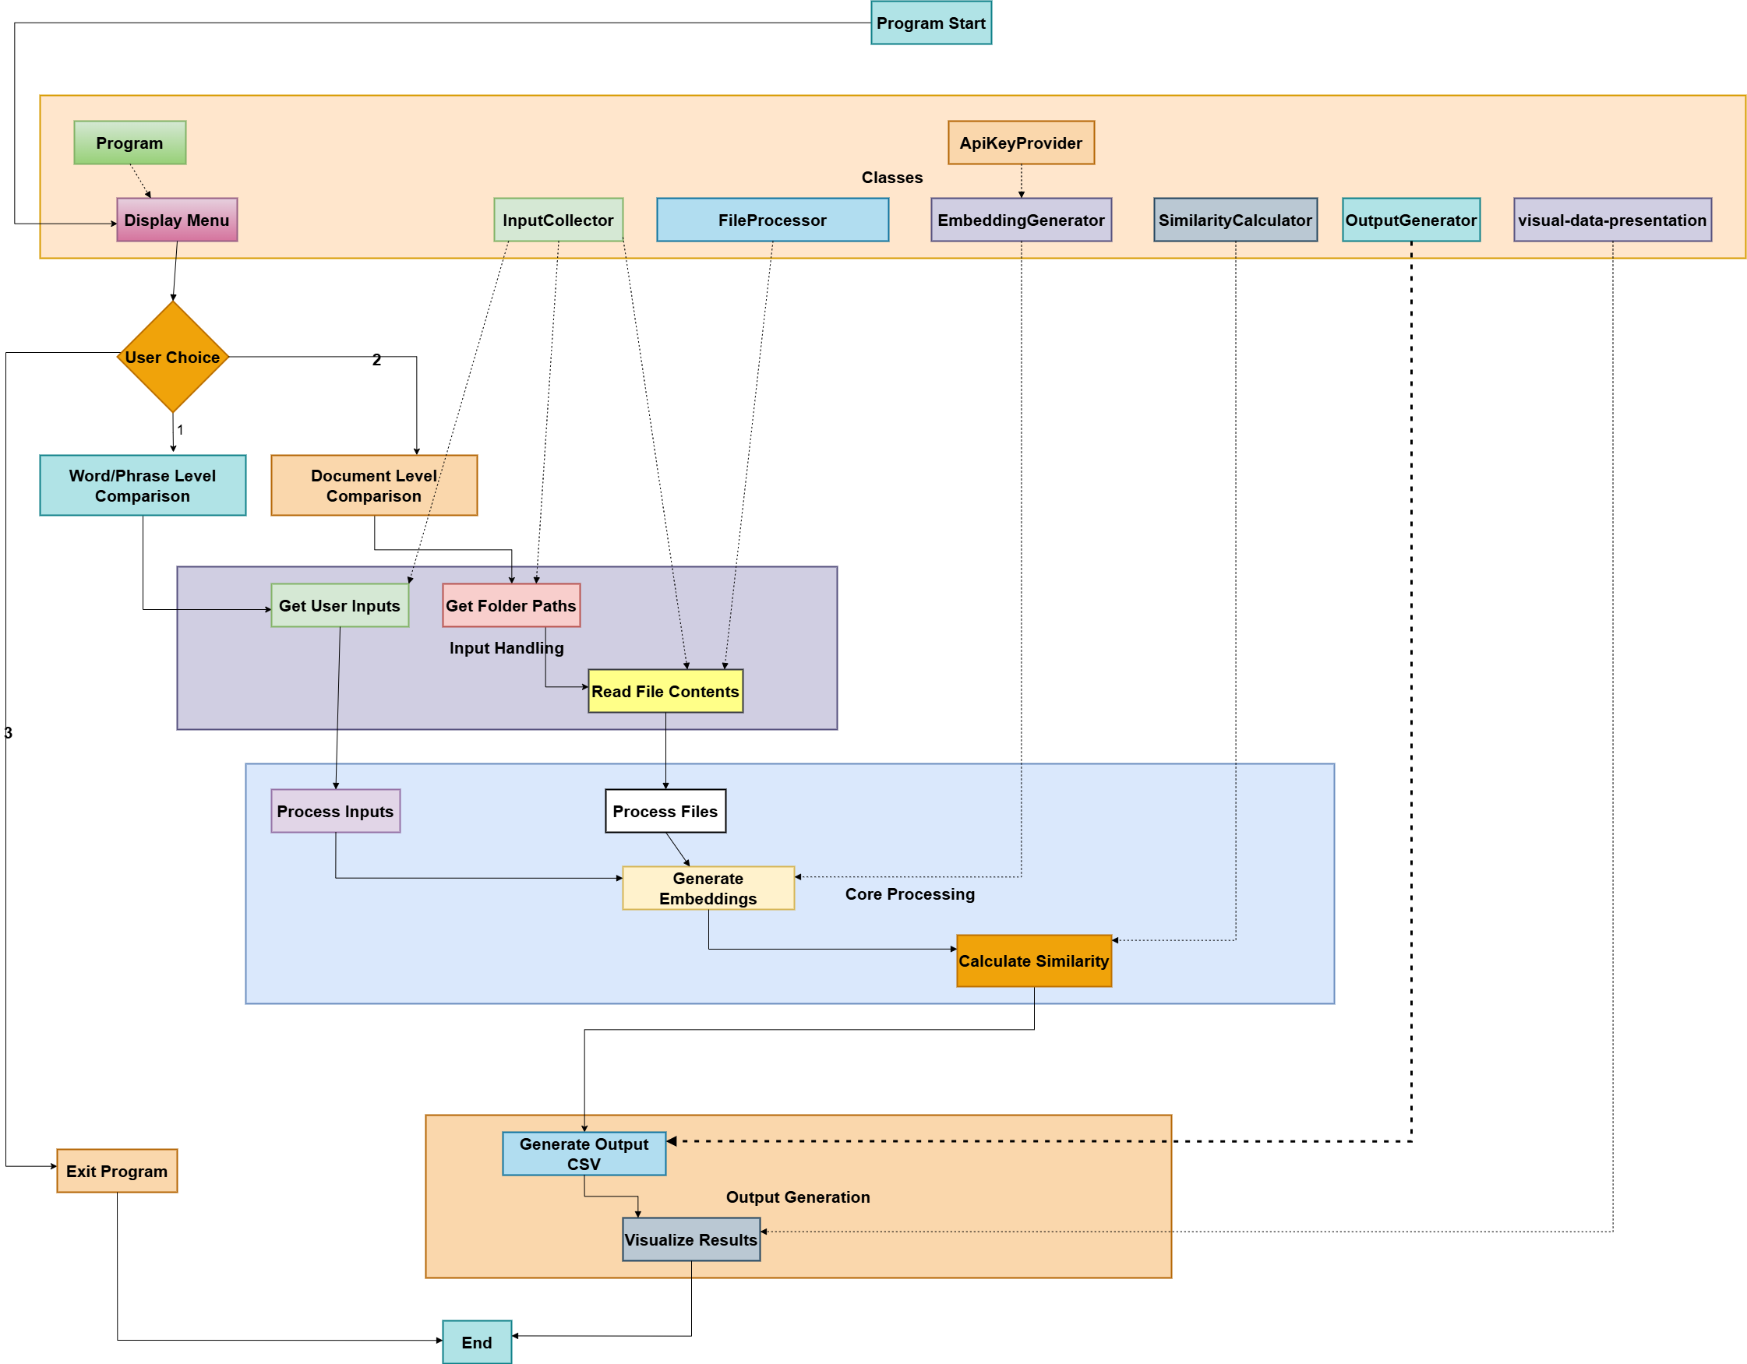
System Architecture Flow Chart

Slide 11
Data Collection and Preprocessing
The system supports two modes of input for similarity analysis:
Word/Phrase Level Comparison:
Users manually input multiple words or phrases, which are stored in a list for processing.
Document Level Comparison:
Users provide directories containing .txt, or .pdf files from which the system extracts textual content for further processing.

Slide 12
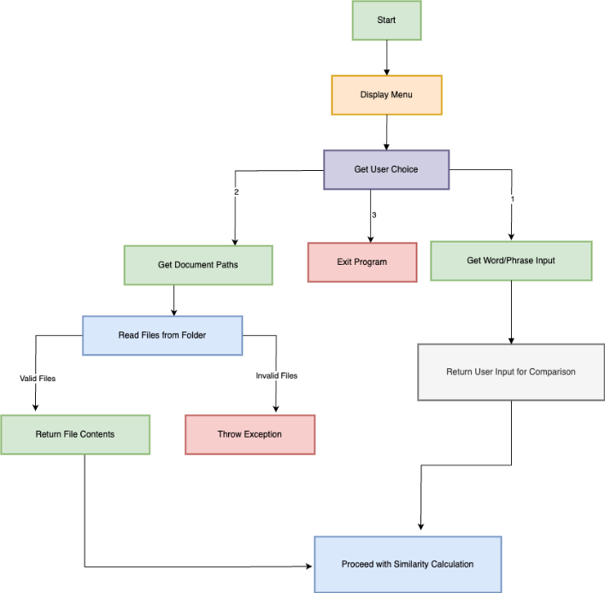
Data Collection Flow Chart

Slide 13
File Parsing & Embedding Generation
File parsing is the process of extracting and interpreting structured data from files (e.g., .txt, .pdf, .docx) so that software can process and analyze the content.
Multi-Format Support
Extracts text from .txt, .pdf, and .docx files.
Uses dedicated libraries:
PDF: “iText7” (page-by-page extraction).
DOCX: “OpenXML SDK” (requires license).
Throws ‘NotSupportedException’ for invalid formats.

Slide 14
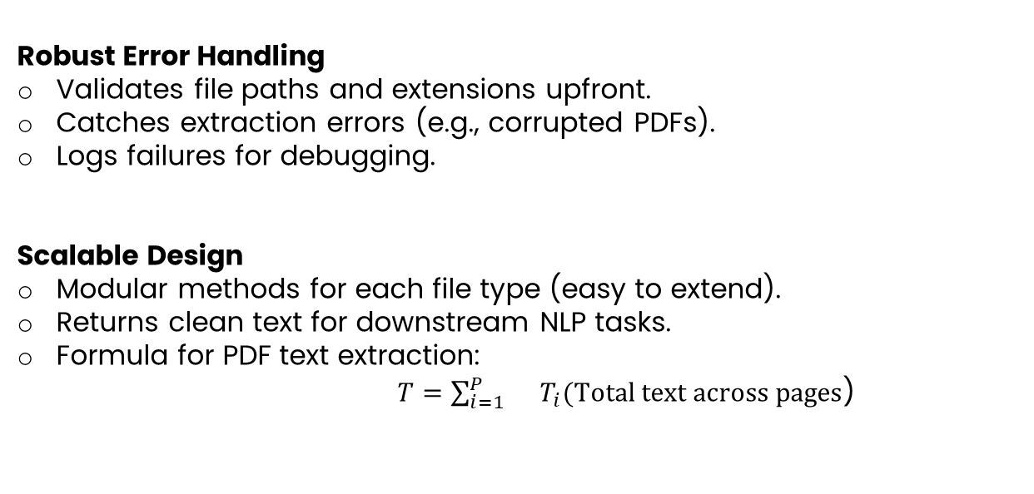
File Parsing & Embedding Generation
Robust Error Handling
Validates file paths and extensions upfront.
Catches extraction errors (e.g., corrupted PDFs).
Logs failures for debugging.
Scalable Design
Modular methods for each file type (easy to extend).
Returns clean text for downstream NLP tasks.
Formula for PDF text extraction:
$T=\sum_{i=1}^{P}{}T_{i}(Total text across pages\text{)}$

Slide 15
Embedding Generation
The EmbeddingGenerator is responsible for retrieving embeddings from OpenAI’s API. The following steps are followed:
API Key Handling: The API key is securely fetched from environment variables using the ApiKeyProvider class.
Embedding Request: Text inputs are sent to OpenAI’s API, specifying the model to be used.
Vector Conversion: The API returns numerical vectors, which are stored for further computation.

Slide 16
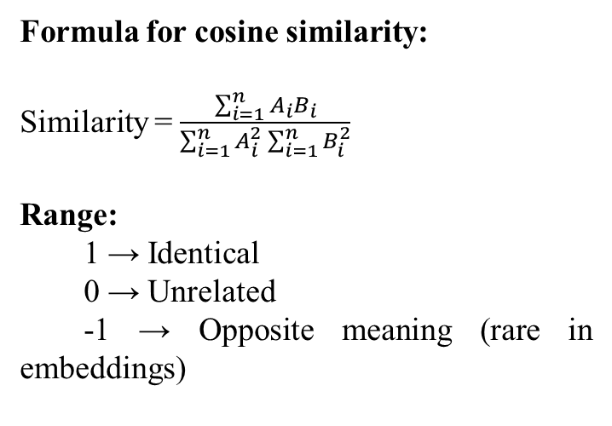
Similarity Computation
Formula for cosine similarity:
Similarity = $\frac{\sum_{i=1}^{n}{A_{i}B_{i}}}{\sum_{i=1}^{n}{A_{i}^{2}}\sum_{i=1}^{n}{B_{i}^{2}}}$
Range:
1 → Identical
0 → Unrelated
-1 → Opposite meaning (rare in embeddings)
The system calculates similarity scores using cosine similarity.
Fetching Embedding’s
Computing Dot Product
Normalizing Scores
Generating Multi-Model Scores

Slide 17
Output Generation and Visualization
This function is responsible for managing the output of the similarity comparison results and saving them to a file.
Structured Results Collection
Gathers similarity scores for all text pairs
Organizes data with:
Source text
Reference text
Scores from each model (Ada/Small/Large)
Automated File Export
Creates standardized CSV files
Ensures consistent naming/location for easy retrieval

Slide 18
Output Generation and Visualization
Progress Tracking
Calculates total comparisons needed (“source × reference”)
Tracks completed pairs in real-time
Provides transparency during batch processing
VisualizationReady Formatting
Structures data for seamless integration with Python/Plotly
Includes metadata needed for charts (model types, text labels)

Slide 19
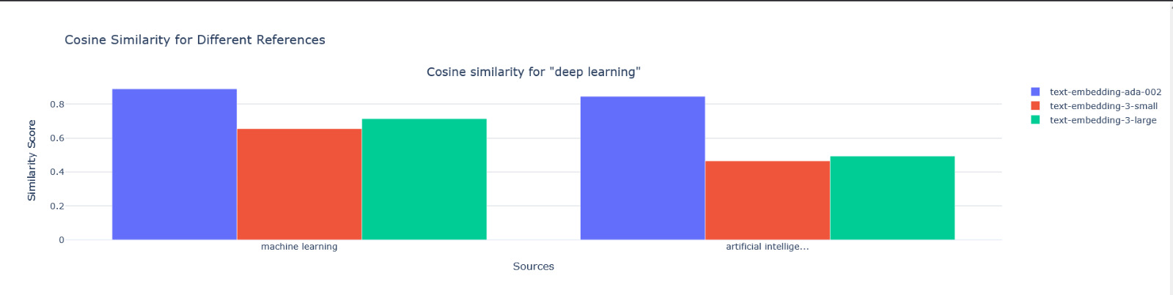
Visualization (Similarity score)

Slide 20
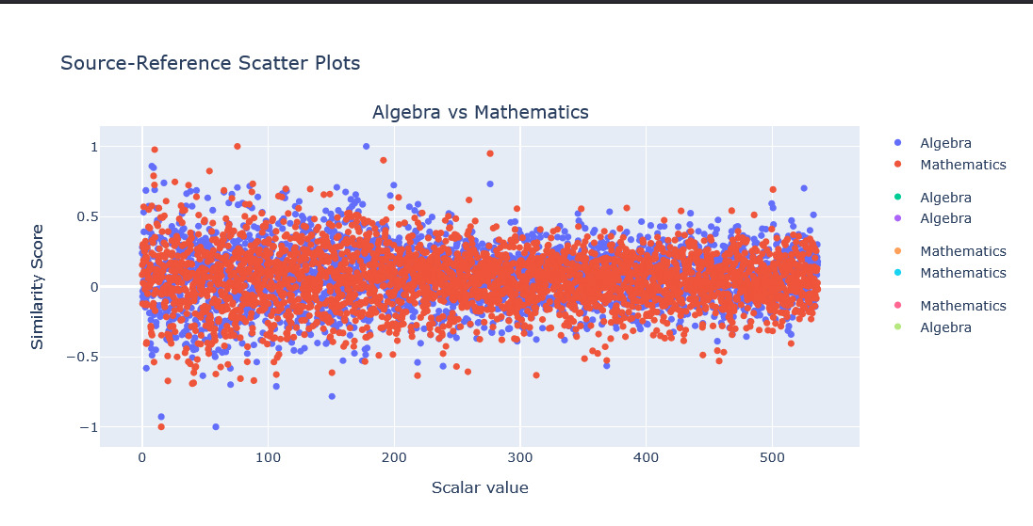
Visualization (Scalar value)

Slide 21
04
Result Analysis

Slide 22
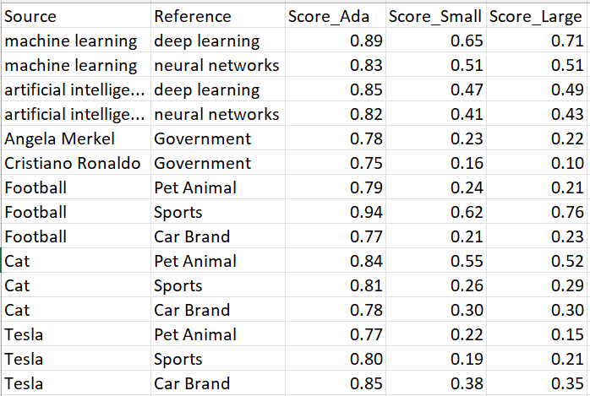
Word & Phrase level similarity
Models captured semantic relationship well
Domain-specific words were well distinguished.
e.g.
"Football" vs. "Sports": High scores (Ada: 0.94, Large: 0.76).
"Tesla" vs. "Sports": Low scores (Large: 0.21).
Technical Terms:
"ML" vs. "DL": 0.71 (Large).
"AI" vs. "Neural Networks": 0.43 (Large).
Conclusion: The Large model gave the most nuanced results.

Slide 23
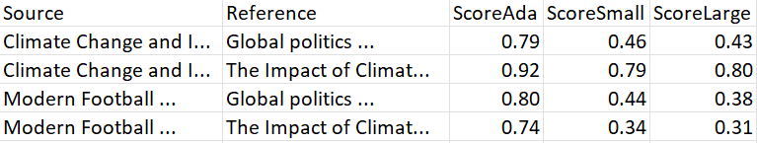
Document level similarity
Similar topics had high similarity scores. e.g. Climate change docs: 0.80 (Large).
Dissimilar topics showed low similarity. e.g. Sports vs. Politics: 0.38 (Large).
Longer documents had more stable scores.
Short documents still showed recognizable patterns
Conclusion: The Large model gave the most nuanced results.

Slide 24
Model Comparison
text-embedding-ada-002: Provide higher scores but less precise
text-embedding-3-small: Provide balance speed and accuracy
text-embedding-3-large: Provide most accurate results but takes comparatively longer time
Processing Times: Ada (809 ms), Small (565 ms), Large (1013 ms).

Slide 25
Limitations
🚫 Dependency on OpenAI API (Requires an API key and usage costs may scale with large datasets.)
🚫 File Format Restrictions (Cannot process .docx files directly due to license limitations)
🚫 Threshold Ambiguity (No universal threshold for "high" or "low" similarity; requires manual calibration per use case)
🚫 Contextual nuances (e.g., sarcasm) are not fully captured.
🚫 Text preprocessing affects similarity results.
🚫 Alternative distance metrics could be explored.

Slide 26
Conclusion
Summary of Findings:
Semantic similarity analysis using OpenAI embeddings is effective for both word/phrase and document-level comparisons.
Different embedding models provide slightly varying results, with large model often capturing more nuanced relationships.

Slide 27
Conclusion
Applications:
This approach can be used in various NLP tasks, such as document clustering, recommendation systems, and search engines.
Future work:
Explore other similarity metrics (e.g. Jaccard similarity, Euclidean distance)
Test on large datasets or different languages.

Slide 28
Thanks!

